Slide 1


SCALATEST Frame WORK
July 2, 2018
Venkataramana Uppara

Slide 2
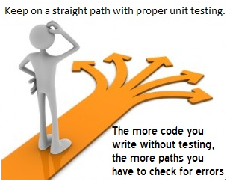
http://www.guru99.com/unit-testing.html

Slide 3
Test-Driven Development (TDD)
TDD is a technique in which you write the tests before you write the code you want to test
This seems backward, but it really does work better
When tests are written first,
You have a clearer idea what to do when you write the methods
The code is necessarily written to be testable
You are encouraged to write simpler, single-purpose methods
Methods tend to be more independent of the environment
They are called from more than one environment (the “real” one, plus your test class)
You are never far away from code that works
You end up with a program that can be modified and maintained safely
To do TDD, it must be easy to create and run tests
Scalatest and JUnit are frameworks that makes this much easier to do

Slide 4
Scalatest is a testing framework inspired by Junit.
Scalatest comes in various styles: FunSuite, FlatSpec, FunSpec, WordSpec, FreeSpec, Spec, PropSpec, and FeatureSpec
Examples of these can be seen at http://www.scalatest.org/user_guide/selecting_a_style
before and after
Like JUnit, Scalatest has methods that are automatically called before each test (to make sure each test starts in a known state) and after each test (to clean up afterward)
before { code }
after { code }
As with JUnit, before is often used, after is seldom used

Slide 5
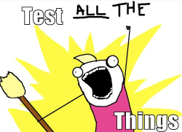
What to test
http://chimera.labs.oreilly.com/books/1234000000754/ch04.html#_programming_is_like_pulling_a_bucket_of_water_up_from_a_well

Slide 6
Simply Writing Tests Is Not Test Driven Development
Uncle Bob’s 3 basic rules of TDD are:
You are not allowed to write any production code unless it is to make a failing unit test pass.
You are not allowed to write any more of a unit test than is sufficient to fail; and compilation failures are failures.
You are not allowed to write any more production code than is sufficient to pass the one failing unit test.
To summarize Uncle Bob’s rules:
Only write code that is tested.
Start your tests small, then work your way up.
Only write enough production code to make a test pass.
The basic process of TDD has 3 steps: Red, Green, and Refactor
http://spin.atomicobject.com/2012/12/06/writing-tests-is-not-tdd/

Slide 7
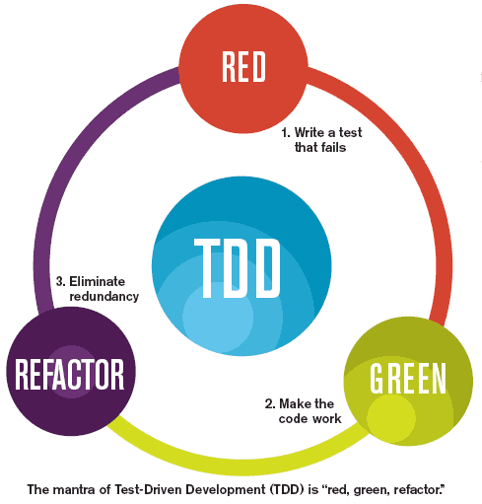
http://diogoosorio.com/blog/entry/test-driven-development-tdd-using-phpunit

Slide 8
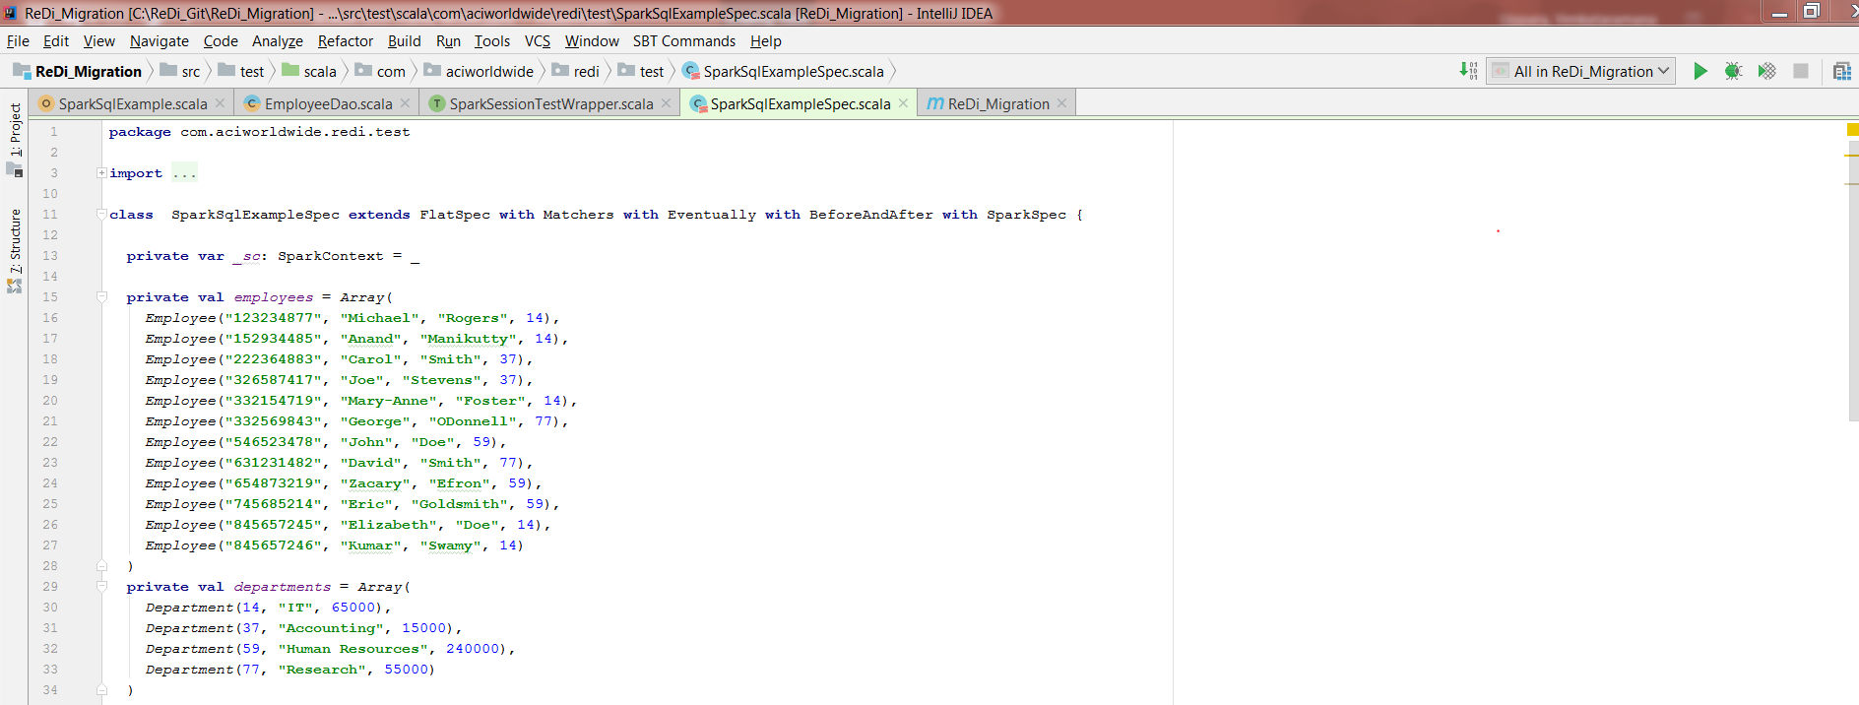
Sample code

Slide 9
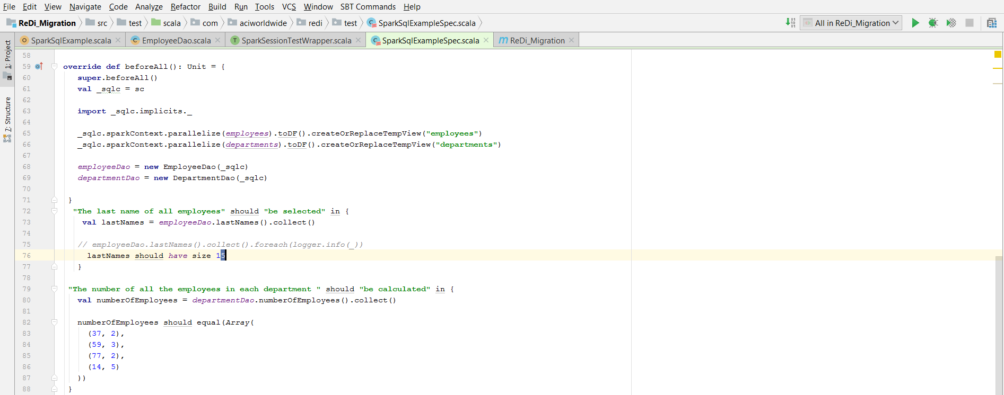

Slide 10
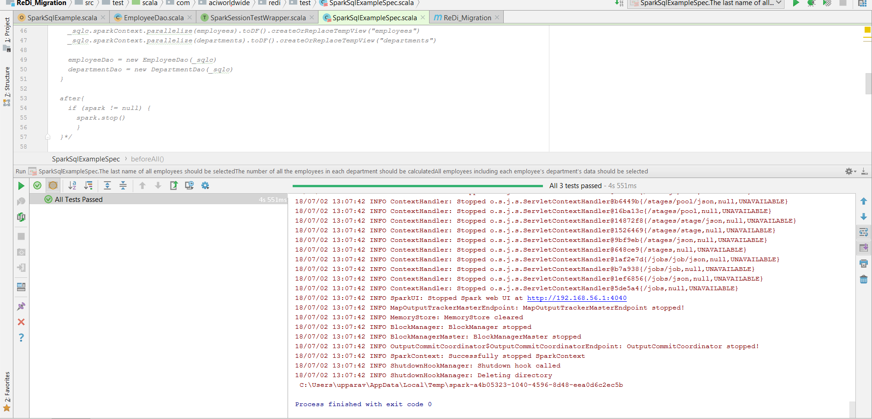
Positive Test Case

Slide 11
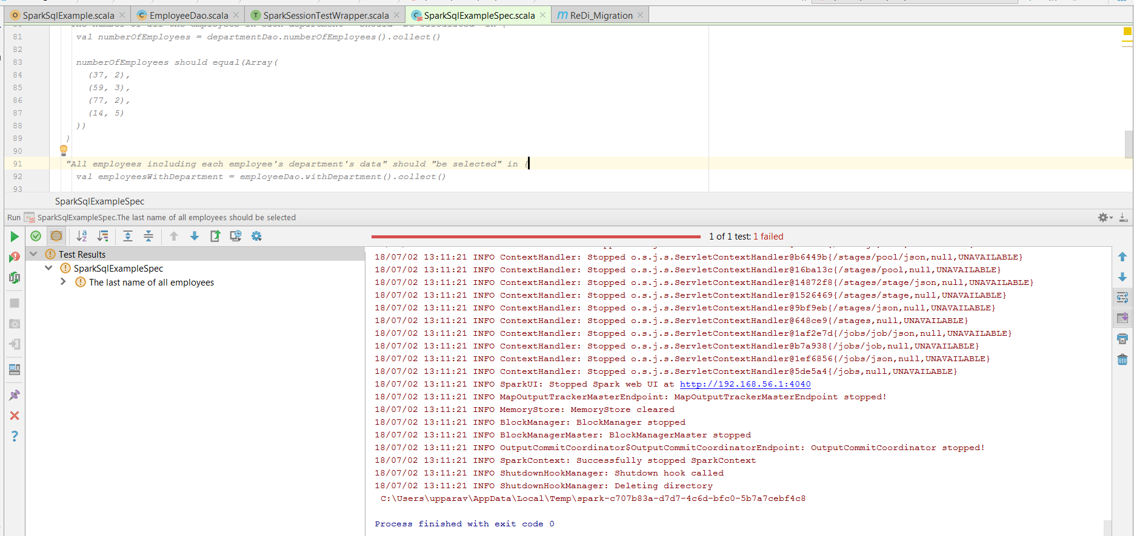
Negative Test case

Slide 12
Thank You

